Slide 1
GEOG0113: Geography in the field
Introduction to GIS & MAPPING
How TO publish your storymap & wrap-up
Dr Anwar Musah (a.musah@ucl.ac.uk)
Lecturer in Social and Geographic Data Science
UCL Geography
1

Slide 2
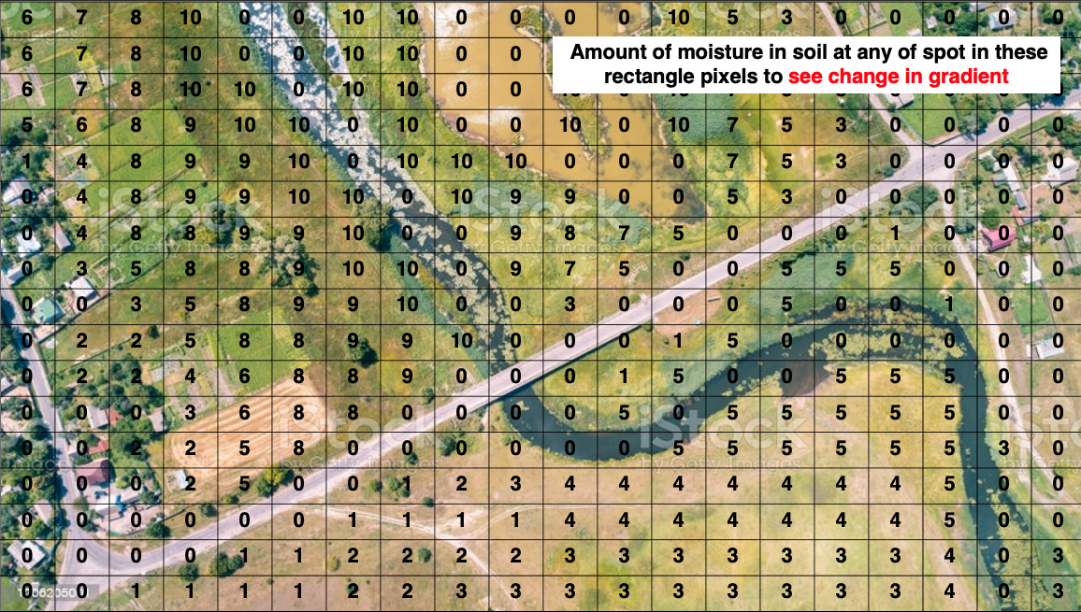
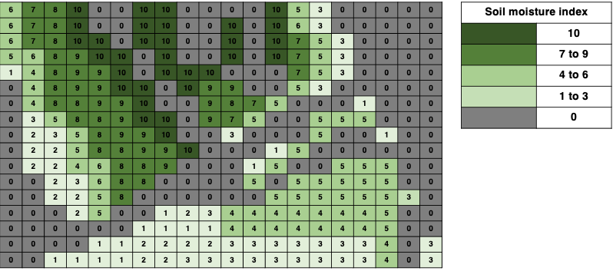
Types of Spatial Data
Type of Vector | Examples
Points | e.g., Sites, Locations etc.
Line segments | e.g., Rivers, roads, rail tracks, Strava route etc.
Polygons | e.g., Postcode, District, Country etc.
Vector
Raster
Vectors represent single or discrete features in geographical space
A raster represents a features that is continuous in geographical space
2

Slide 3
Types of Spatial Data
Type of Vector | Examples
Points | e.g., Sites, Locations etc.
Line segments | e.g., Rivers, roads, rail tracks, Strava route etc.
Polygons | e.g., Postcode, District, Country etc.
Vector
Raster
Vectors represent single or discrete features in geographical space
A raster represents a features that is continuous in geographical space
3

Slide 4
Types of Spatial Data
Notes:
Vector data are stored usually as a shape file or GPS Exchange Format file
Shapefile is has an extension of .shp but it comes with 3-5 other files which must be kept to together or you cannot open it (i.e., .shx, .dbf, .cpg, .prj)
The GPS Exchange Format file has an extension of .gpx. You usually get this format if spatial data is exported out of some application.
Type of Vector | Examples
Points | e.g., Sites, Locations etc.
Line segments | e.g., Rivers, roads, rail tracks, Strava route etc.
Polygons | e.g., Postcode, District, Country etc.
Vector
Vectors represent single or discrete features in geographical space
4

Slide 5
Any questions?
a.musah@ucl.ac.uk
5

